Slide 1

Ecommerce Sales Performance Dashboard Finarius Group
Interactive Power BI Dashboard |
Data Analysis & Business Insights
Prepared By: Muhammad Qasim Sial
Data Analyst

Slide 2
Major Findings Include
✅ Total Revenue
✅ Customer Retention Rate
✅ Top Customers by Lifetime Value
✅ Category-wise Sales & Return Rate
✅ Total Customers by Gender
✅ Total Orders
✅ Total Customers
✅ Average Order Value By Gender
✅ Top Products by Units Sold
✅ City-wise Customer Count
✅ Bottom Products by Revenue
✅ Monthly Sales Trend
✅ Category-wise Cancellation vs Return Rate And Much More

Slide 3
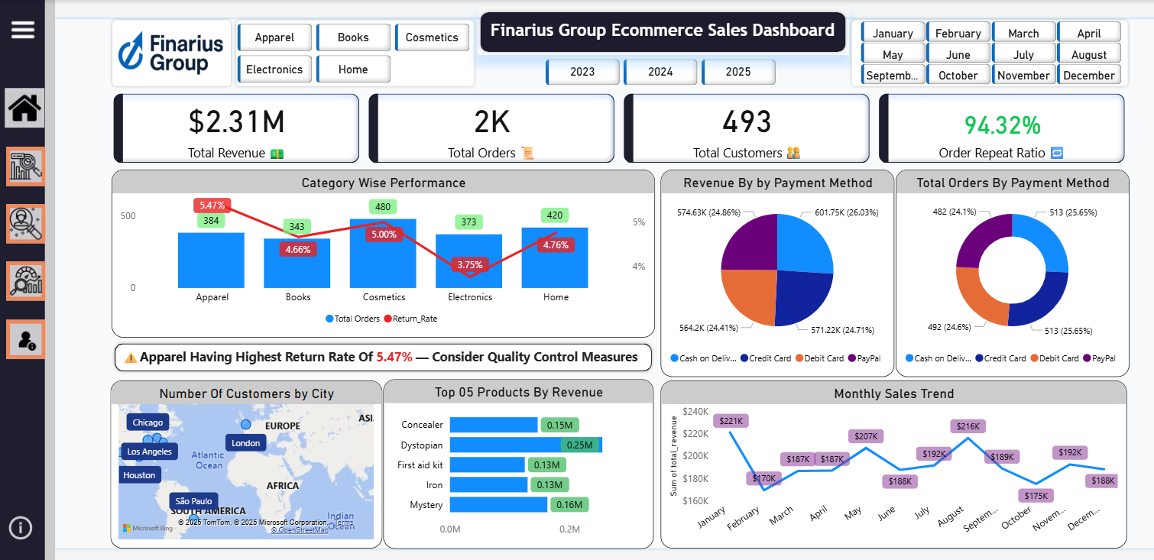
Welcome & Overview
A quick glance at our latest performance and key metrics
Disclaimer: All data in this project is dummy for learning and demonstration purposes. It does not represent any real company or individual.

Slide 4
Welcome & Overview
A quick glance at our latest performance and key metrics
KPIs Include:
Total Revenue: $2.31M
Total Orders: 2K
Total Customers: 493
Order Repeat Ratio: 94.32%
Category Wise Sales & Return Rate
Apparel has the highest return rate (5.47%) followed by Cosmetics (5.00%) — quality control action required.
Electronics has the lowest return rate (3.75%) — positive customer
experience.

Slide 5
Welcome & Overview
Revenue by Payment Method
Balanced distribution between payment modes — Credit Card and Cash on Delivery are top contributors.
Total Orders by Payment Method
Order share follows revenue distribution — consistent customer payment preferences.
Monthly Sales Trend
Peak in August ($216K), lowest in February ($170K) — possible seasonality effect.
Number of Customers by City
Major customer base in Chicago, Los Angeles, Houston, São Paulo, London.
Top Products by Revenue
Dystopian ($0.25M) is the top revenue generator, followed by Mystery and
Concealer.

Slide 6
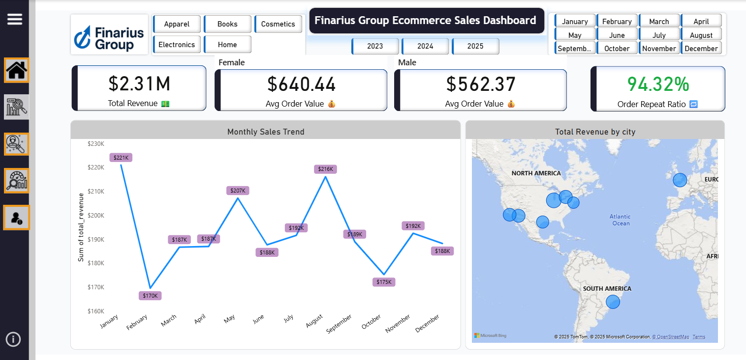
Sales Insights
A quick glance at our latest performance and key metrics

Slide 7
Sales Insights
Monthly Sales Trends
Revenue recovery post-February dip — strong Q3 performance.
January, May and August are Top performing with >$200K sales.
Revenue By City
Chicago, London, and São Paulo dominate sales.
New York, Houston and Los Angeles struggle in sales.

Slide 8
Sales Insights
Average Order Value By Gender
Male ($562.37)
Female ($640.44)
💎 Gather feedback from female customers to improve product selection and shopping experience.

Slide 9
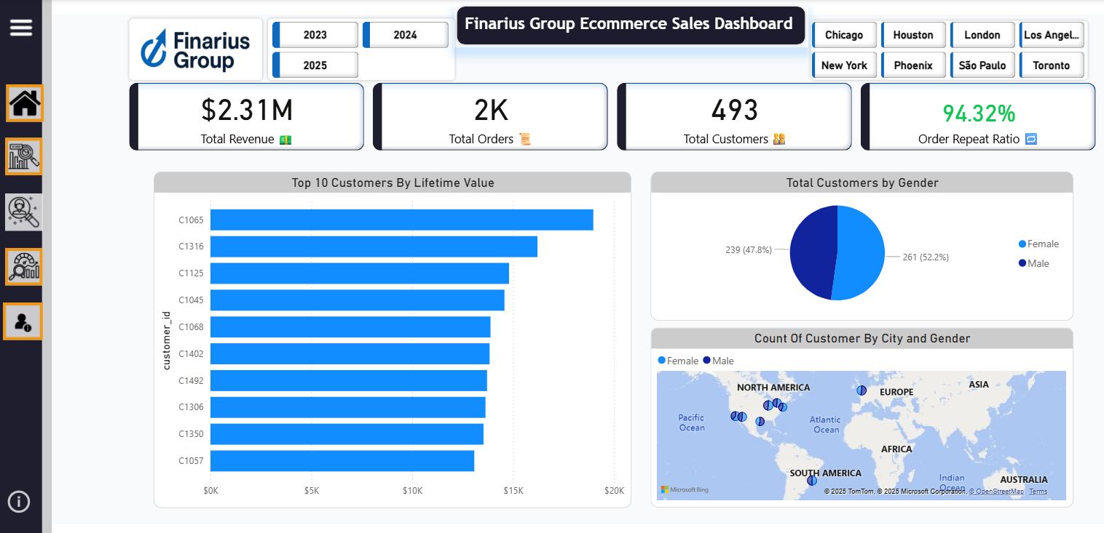
Customers Insights
A quick glance at our latest performance and key metrics

Slide 10
Customers Insights
Total Customers By Gender
Male 261(53.06%)
Female 239(47.94%)
Region-wise Customers By Gender
America
Male 203(46.99%)
Female 229(53.01%)
Europe
Male 36(52.94%)
Female 32(47.06%)

Slide 11
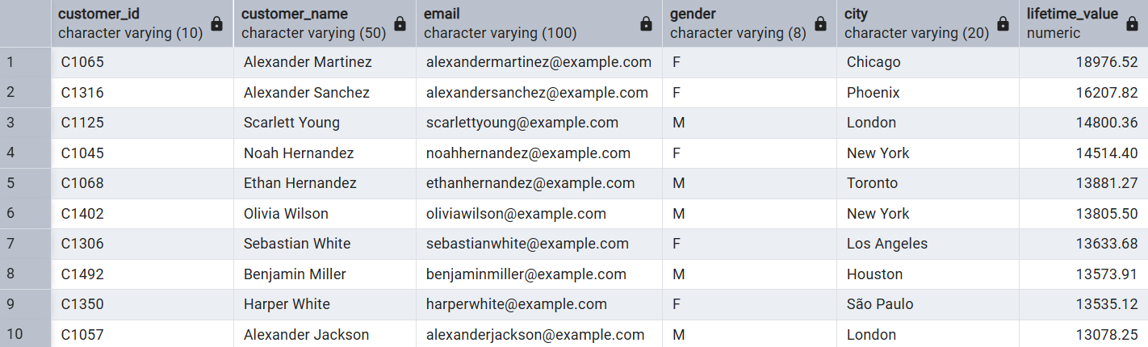
Customers Insights
Top 10 Customers By Lifetime Value

Slide 12
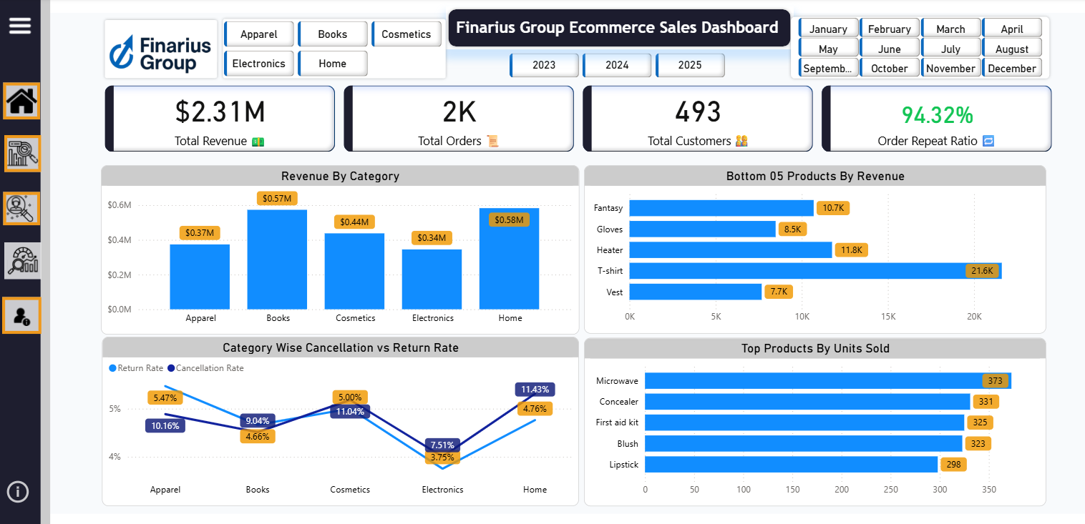
Product Performance
A quick glance at our latest performance and key metrics

Slide 13
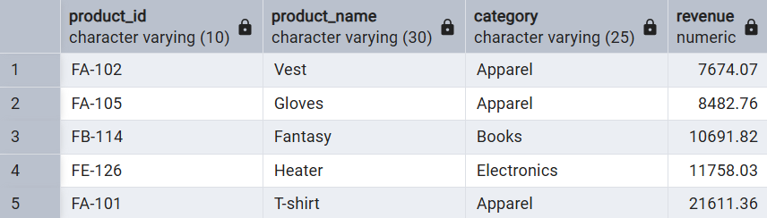
Product Performance
Revenue By Category
Apparel leads in sales volume but also in return rate.
Bottom 05 Products By Revenue

Slide 14
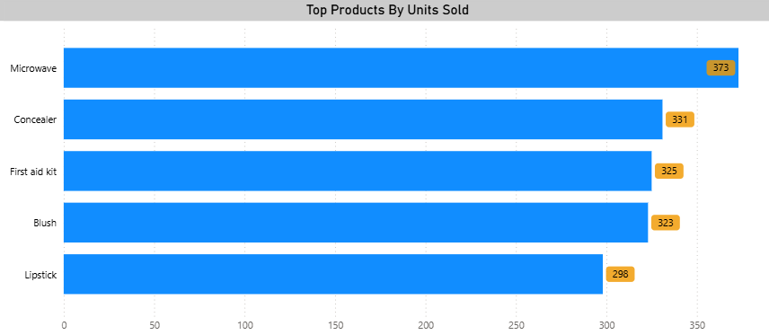
Product Performance
Category-wise Cancellation vs Return Rate
Apparel has the highest return rate followed by Cosmetics while Books and Electronics have Lowest cancellation rates.
Top Products By Units Sold

Slide 15
Skills Utilized
Data Cleaning & Transformation (Power Query, SQL)
Data Modeling (Relationships, DAX measures in Power BI, Conditional Formatting, Bookmarks and Navigation)
KPI Development (Revenue, Orders, Customers, Repeat Ratio, Average Order Value By Gender)
Visualization Design (Charts, slicers, maps, interactive dashboards)
Business Analysis (Identifying trends, seasonality, customer behavior)
Storytelling with Data (Highlighting actionable insights for decision- makers)

Slide 16
Business Solutions
Apparel Return Reduction Program
Conduct product quality audits.
Offer size guides & better product descriptions.
Payment Method Marketing
Offer incentives for low-fee payment methods to reduce transaction costs.
Seasonal Promotion Strategy
Target low-sales months with discounts.
Push high-demand categories before peak season.

Slide 17
Business Solutions
Customer Loyalty Programs
Special offers for top lifetime value customers.
Personalized marketing by purchase history.
Product Portfolio Optimization
Promote best-selling, high-margin products.
Phase out low-performing SKUs.

Slide 18
About Me
Hello, I’m Muhammad Qasim Sial
Skilled in Data Analysis • SQL • Statistics • Excel • Power BI along with various other analytical skills, I’m
passionate about turning raw data into meaningful business insights.
I am actively open to opportunities as a Data Analyst in Full-time | Part-time | Remote or Contract roles.
If my skills align with your needs, I would be happy to connect and explore how I can contribute to your
projects or team.
Mobile: +968 92401026
Email: sial.insights@gmail.com
LinkedIn: https://www.linkedin.com/in/muhammad-qasim-sial-00994a378/
GitHub: https://github.com/sial22
Thank You

